Slide 1

Welcome To Our Presentation
Car Parking System Using Arduino
Submited By:
Md. Tanjil Hossain Midul
Id: 0692220005101014
Batch : CSE-19
Md Tasdiqul Huq
Id:0692220005101006
Batch : CSE-19
Mahin Hossain
Id:0692310005101008
Batch : CSE-21
01

Slide 2
Introduction
The project aims to create an automated car parking system using Arduino, which efficiently manages parking spaces by detecting vehicle presence and controlling parking barriers. The system enhances user experience and optimizes space utilization in parking facilities.
02

Slide 3
Objective
The primary goal of the project is to develop a smart parking system that automates the process of parking and retrieval, provides real-time information on parking spot availability, and improves overall efficiency in managing parking spaces.
03

Slide 4
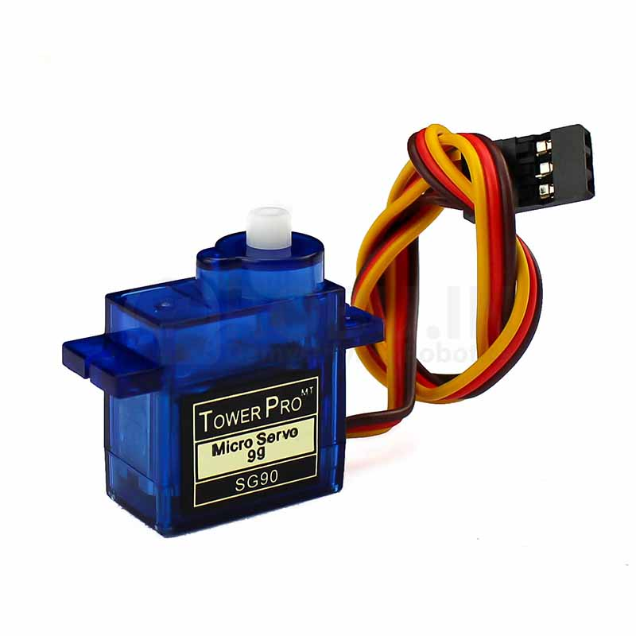
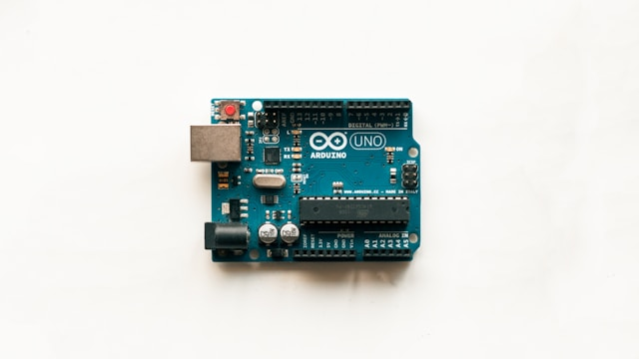
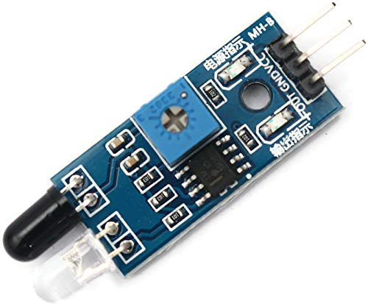
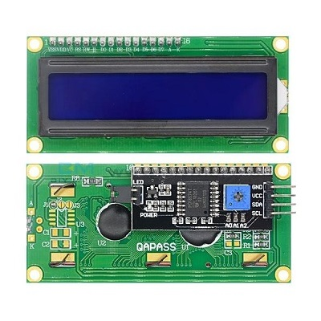
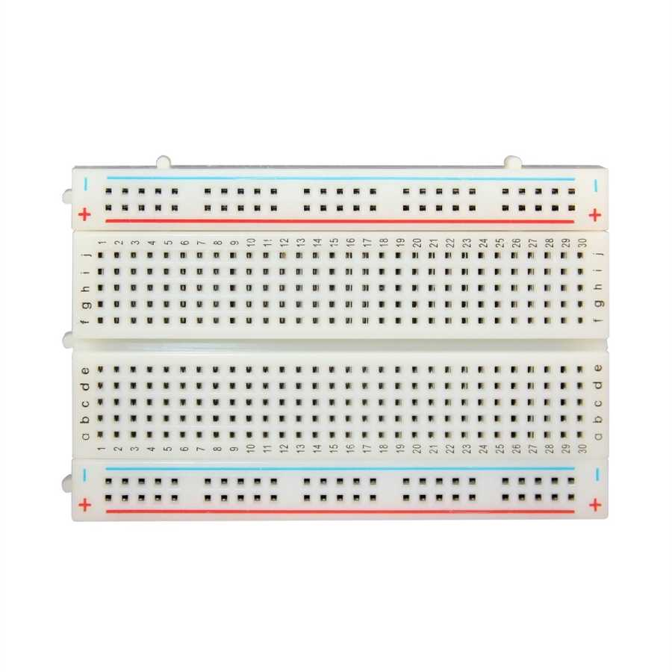
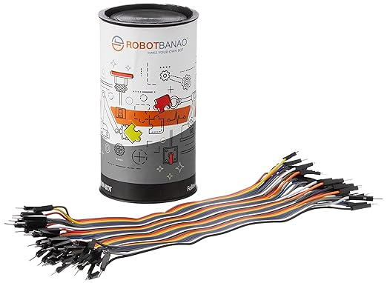
Components We Used
Arduino Uno
IR Sensor
Servo Motors
Jumper Wires
LCD Display With I2C Module
Breadboard
04

Slide 5
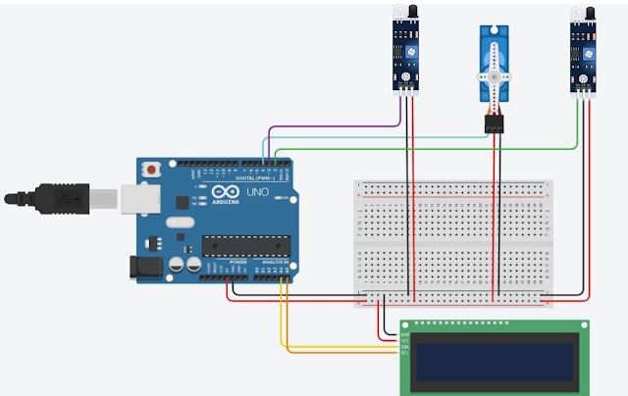
Circuit Diagram
05

Slide 6
Working Rule
The IR Sensor detects the presence of a vehicle in a parking space. When a car enters the parking spot, the sensor sends a signal to the Arduino, which then activates the servo motor to open the parking barrier. The LED display shows the availability of parking spots. When the car leaves, the sensor detects the absence of the vehicle, and the barrier closes automatically.
06

Slide 7
Arduino Code
#include <Wire.h>
#include <LiquidCrystal_I2C.h>
LiquidCrystal_I2C lcd(0x27,16,2);
#include <Servo.h>
Servo myservo;
int IR1 = 2;
int IR2 = 3;
int Slot = 4; //number of parking Slots
int flag1 = 0;
int flag2 = 0;
void setup() {
Serial.begin(9600);
lcd.init(); //initialize the lcd
lcd.backlight(); //open the backlight
pinMode(IR1, INPUT);
pinMode(IR2, INPUT);
myservo.attach(4);
myservo.write(100);
lcd.setCursor (0,0);
lcd.print(" ARDUINO ");
lcd.setCursor (0,1);
lcd.print(" PARKING SYSTEM ");
delay (2000);
lcd.clear();
}
void loop(){
if(digitalRead (IR1) == LOW && flag1==0){
if(Slot>0){flag1=1;
if(flag2==0){myservo.write(0);
Slot = Slot-1;}
}else{
lcd.setCursor (0,0);
lcd.print(" SORRY :( ");
lcd.setCursor (0,1);
lcd.print(" Parking Full ");
delay (3000);
lcd.clear();
}
}
if(digitalRead (IR2) == LOW && flag2==0){flag2=1;
if(flag1==0){myservo.write(0);
Slot = Slot+1;}
}
if(flag1==1 && flag2==1){
delay (1000);
myservo.write(100);
flag1=0, flag2=0;
}
lcd.setCursor (0,0);
lcd.print(" WELCOME! ");
lcd.setCursor (0,1);
lcd.print("Slot Left: ");
lcd.print(Slot);
}
delay (2000);
lcd.clear();
}
07

Slide 8
Advantages and Disadvantages
Advantages:
- Efficient use of parking spaces
- Automation reduces human error
- Provides real-time parking availability information
Disadvantages:
- Initial setup cost
- Maintenance may be required
08

Slide 9
Conclusion:
In conclusion, the Arduino-based car parking system offers a smart and automated solution for managing parking spaces effectively. By integrating technology with parking management, this project aims to improve the overall parking experience for users while optimizing space utilization.
09

Slide 10
Thank You .
10

